Slide 1
Combination Methods Exploration & Dataset Description
Junfan Huang
Notes:
Hi everyone, I want to explore the combination methods for our summer project and will talk a little bit about dataset description if I have time left

Slide 2
Outline
Machine learn & vulnerability detection
Inductive Logic Programming
Deep learning
What’s else?
Notes:
As you are aware that we are going to do bug detection by applying machine learning algorithms. Sam and Syd have already explained the ILP and Deep learning and their usage in cyber world, but they didn’t mention the disadvantages of them which I will tell you the truth. Life is not amazing.

Slide 3
ILP is trying to find the rule fits the positive examples

Slide 4
ILP

Slide 5
ILP
rule1

Slide 6
ILP
rule1

Slide 7
ILP
rule2
rule1

Slide 8
ILP
rule = rule + rule2

Slide 9
ILP
rule = rule1 + rule2
rule3

Slide 10
ILP
rule = rule1 + rule2 + rule3

Slide 11
ILP for mislabeled data
rule = rule1 + rule2 + rule3

Slide 12
ILP for mislabeled data
rule = rule1 + rule2 + rule3

Slide 13

Inductive logic programming
Data efficient
Interpretable
Extrapolation
Noise Robustness

Slide 14
Deep learning
Noise Robustness

Slide 15
Deep Learning
Data efficient
Noise Robustness
Interpretable
Extrapolation

Slide 16
We want to find a
good combination

Slide 17
Combination
DNN
ILP
ILP
DNN

Slide 18
Inductive logic programming
Mislabelled data
Interpretable
Extrapolation
Mislabelled data
Interpretable
Extrapolation

Slide 19
Learning explanatory rules from noisy data

Slide 20
How to achieve this
Ground atoms from {False, True} Space map to the real unit interval [0,1]
Clauses also use continuous weights to represents how likely this rule is true.

Slide 21
How to achieve this
Each clause c is compiled into a function from valuations to valuations

Slide 22
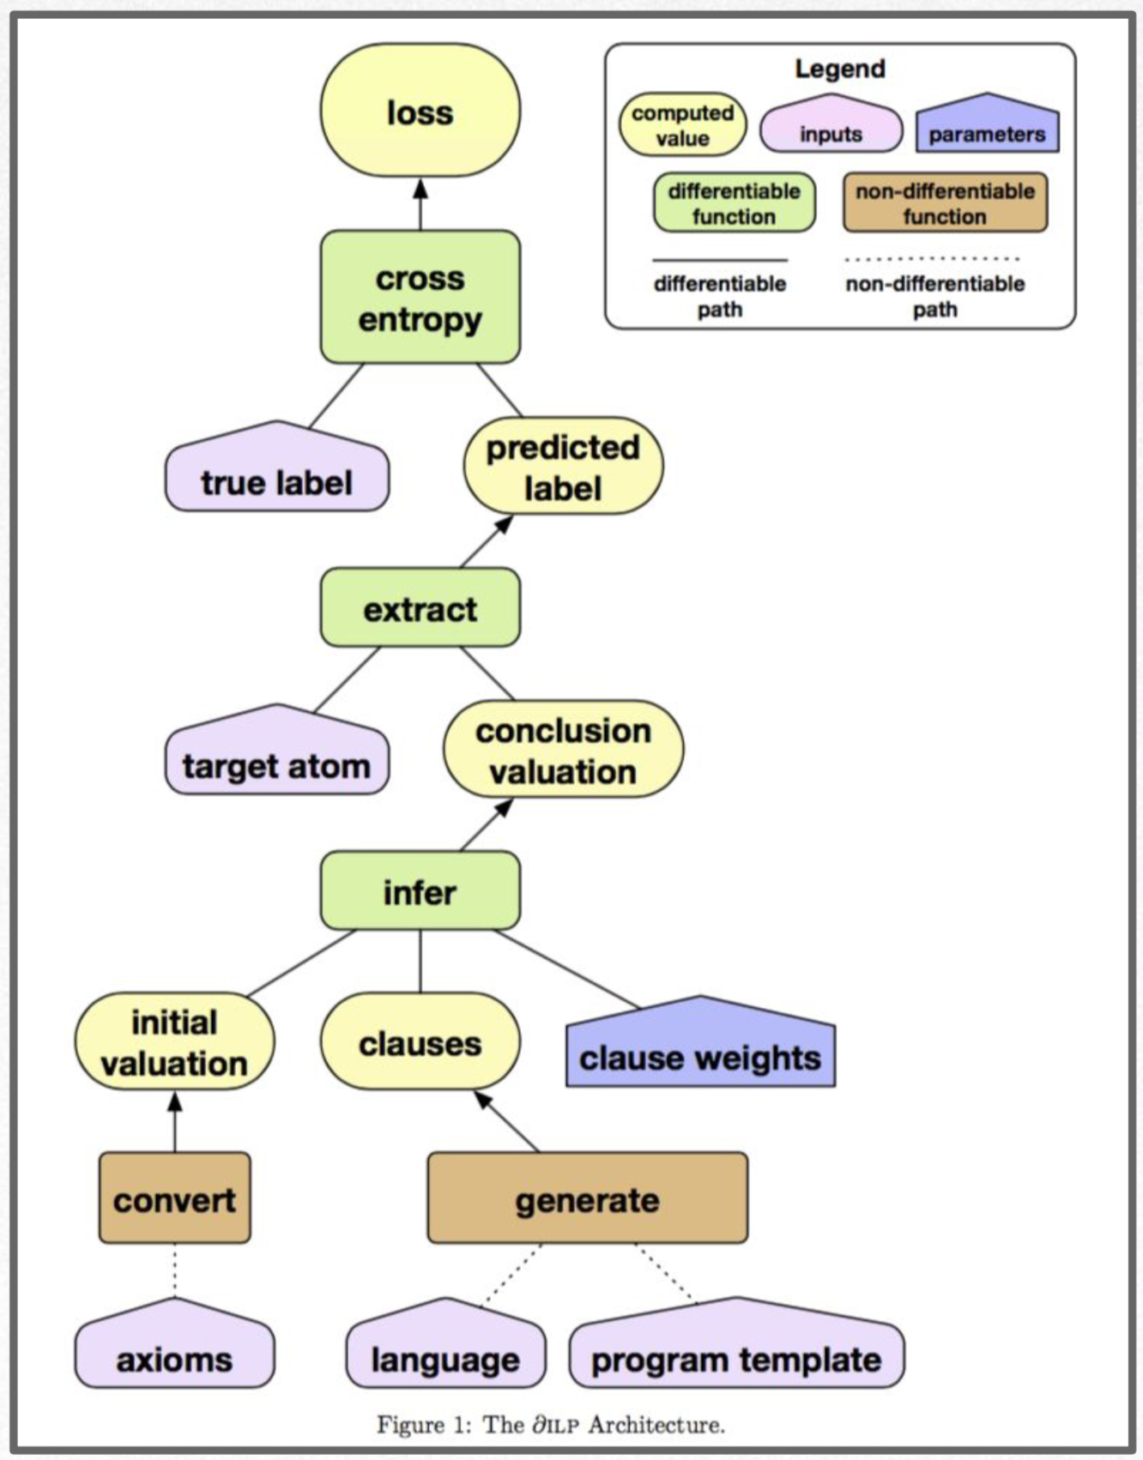
Learning explanatory rules from noisy data
Notes:
In the button of the diagram, the left axioms is background knowledge, and right is using program template to generate the clauses, and give it a initial weight which represents how likely this rule is true. Then infer it in a differentiable way (which use a function to represent each clause), then get a conclusion, by extracting the conclusion for particular atom, it can do a prediction and compared to the true label, we can calculate the cross entropy and get the loss function. Because this system is differentiable, we can go all the way down to update the weight by using gradient descent.

Slide 23
Simulation – learn “less 2” rule
Background Knowledge (less 1)
0 and 1 , 1 and 2 , 2 and 3 , 3 and 4 , ….

Slide 24
Simulation – learn “less 2” rule
Positive examples
0 and 2 , 1 and 3 , 2 and 4 , 3 and 5 , ….

Slide 25
Simulation – learn “less 2” rule
Negative examples
0 and 0 , 0 and 1 , 0 and 3 , 0 and 4 , ….

Slide 26
Simulation – learn less than 2
Background Knowledge
[less1(0,1), less1(1,2), less1(2,3), less1(3,4), less1(4,5), …]
Positive examples
[less2(0,2), less2(1,3), less2(2,4), less2(3,5), …]
Negative examples
[less2(0,0), less2(1,0), less2(3,0), less2(4,0), less2(5,0), less2(6,0), …]
Want to learn the rule of larger than 2
less2(X,Y)

Slide 27
Simulation – learn “less 2” rule
less2(X,Y) :- less1(X,Z), less1(Z,Y)

Slide 28
Simulation – learn less 2
Background Knowledge
[less1(0,1), less1(1,2), less1(2,3), less1(3,4), less1(4,5), …]
Positive examples
[less2(0,2), less2(1,3), less2(2,4), less2(3,5), …]
Negative examples
[less2(0,0), less2(1,0), less2(3,0), less2(4,0), less2(5,0), less2(6,0), …]
Want to learn the rule of larger than 2
less2(X,Y) (given B, P, N)

Slide 29
Simulation – learn less 2
Background Knowledge
[less1(0,1), less1(1,2), less1(2,3), less1(3,4), less1(4,5), …]
Positive examples
[less2(0,2), less2(1,3), less2(2,4), less2(3,5), …]
Negative examples
[less2(0,0), less2(1,0), less2(3,0), less2(4,0), less2(5,0), less2(6,0), …]
Want to learn the rule of larger than 2
less2(X,Y) :- less1(X,Z), less1(Z,Y)

Slide 30
less2(X_0,X_1) :- less1(X_0,X_0),less1(X_1,X_2)
less2(X_0,X_1) -> less1(X_0,X_2),less1(X_2,X_1)
step 0 loss is 0.5620753169059753 less2(0,0) Expected: 0 0.202
less2(0,1) Expected: 0 0.802
less2(0,2) Expected: 1 0.318 (positive)
less2(0,3) Expected: 0 0.000
less2(0,4) Expected: 0 0.000
less2(0,5) Expected: 0 0.000
less2(0,6) Expected: 0 0.000
less2(0,7) Expected: 0 0.000
less2(0,8) Expected: 0 0.000
less2(0,9) Expected: 0 0.000
less2(1,0) Expected: 0 0.908
less2(1,1) Expected: 0 0.385
step 440 loss is 1.6123104842336033e-06
less2(0,0) Expected: 0 0.000
less2(0,1) Expected: 0 0.000
less2(0,2) Expected: 1 1.000
less2(0,3) Expected: 0 0.000
less2(0,4) Expected: 0 0.000
less2(0,5) Expected: 0 0.000
less2(0,6) Expected: 0 0.000
less2(0,7) Expected: 0 0.000
less2(0,8) Expected: 0 0.000
less2(0,9) Expected: 0 0.000
less2(1,0) Expected: 0 0.000
less2(1,1) Expected: 0 0.000

Slide 31
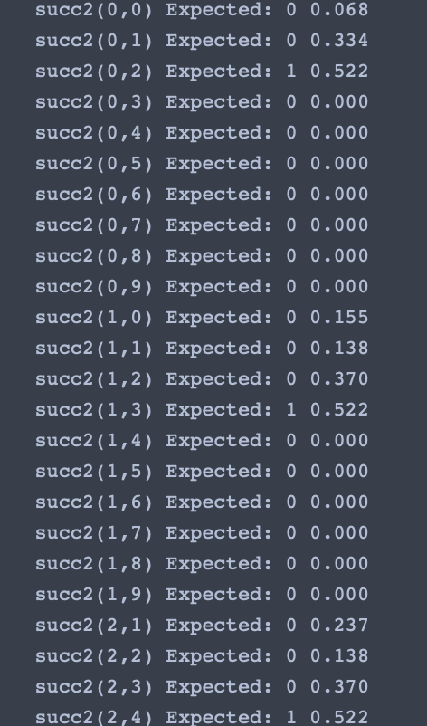
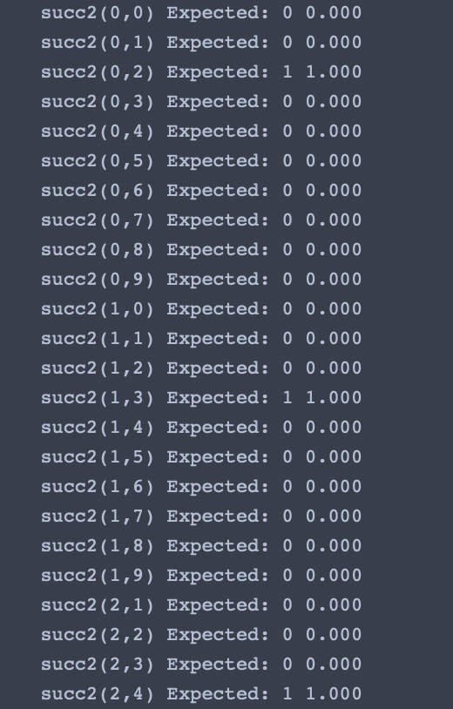
succ2(X_0,X_1) :- succ(X_0,X_0),succ(X_2,X_1)
succ2(X_0,X_1) :- succ(X_0,X_2),succ(X_2,X_1)

Slide 32
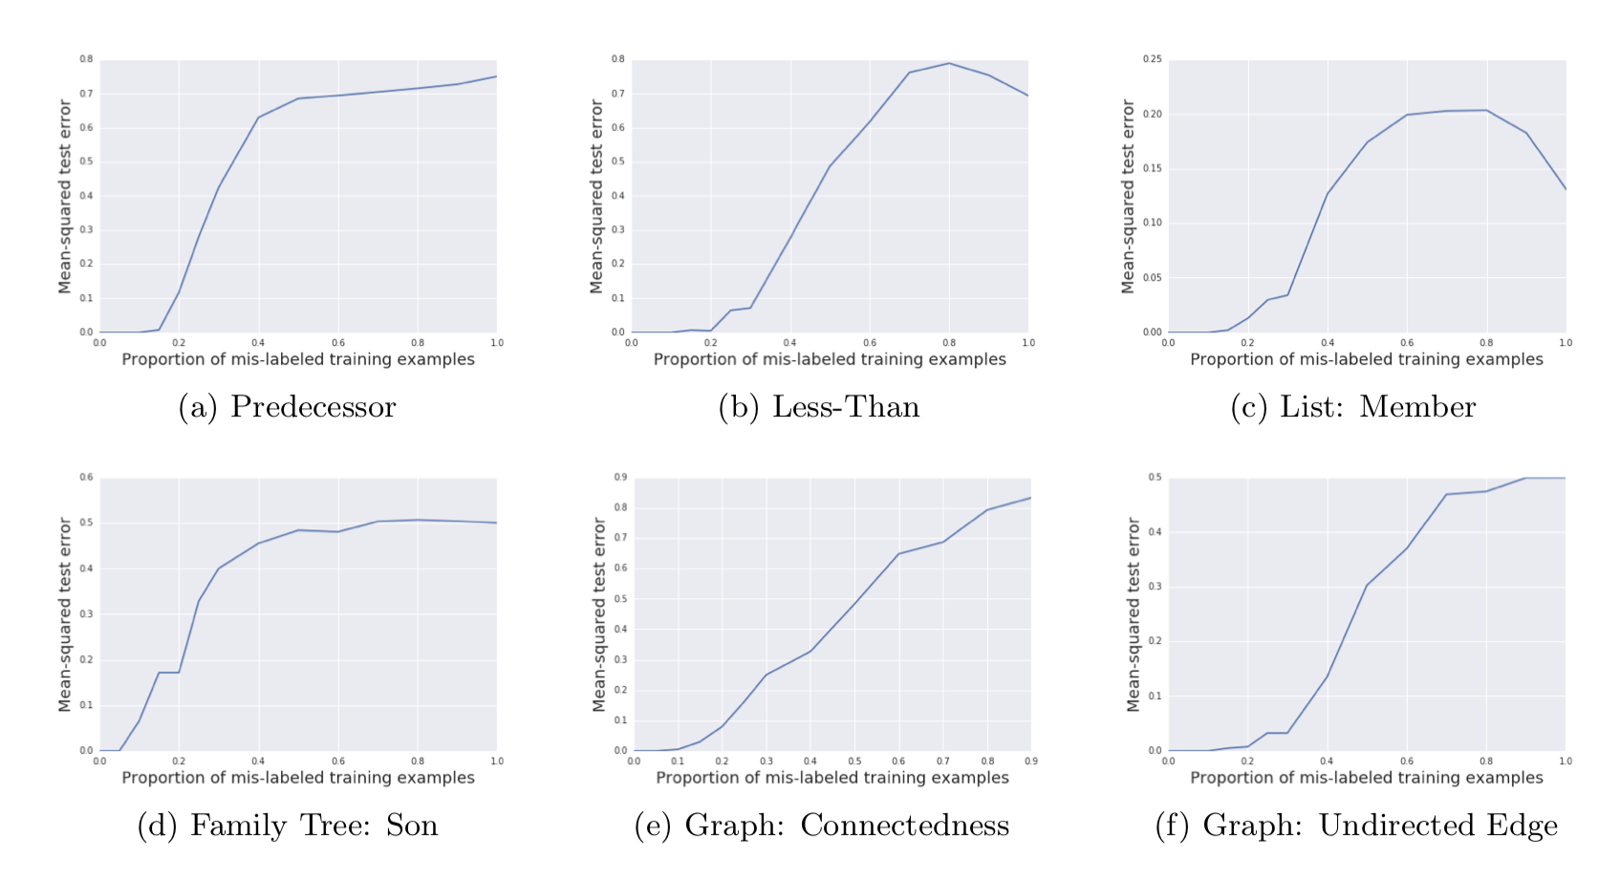
Mis-labelled a certain proportion ρ of the training examples.

Slide 33
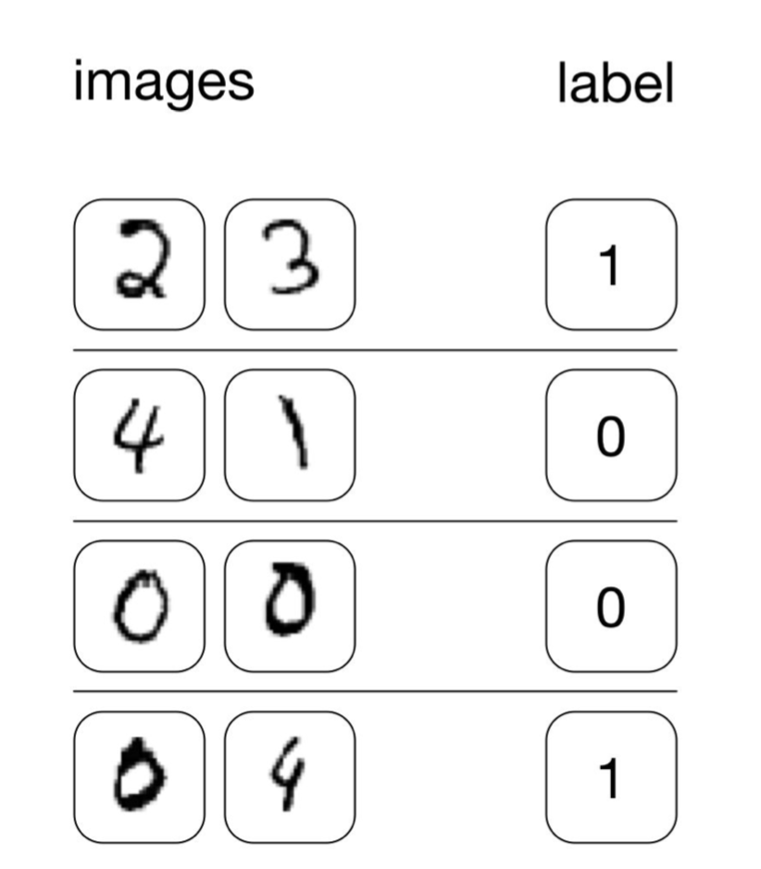
Learn less than
from images

Slide 34
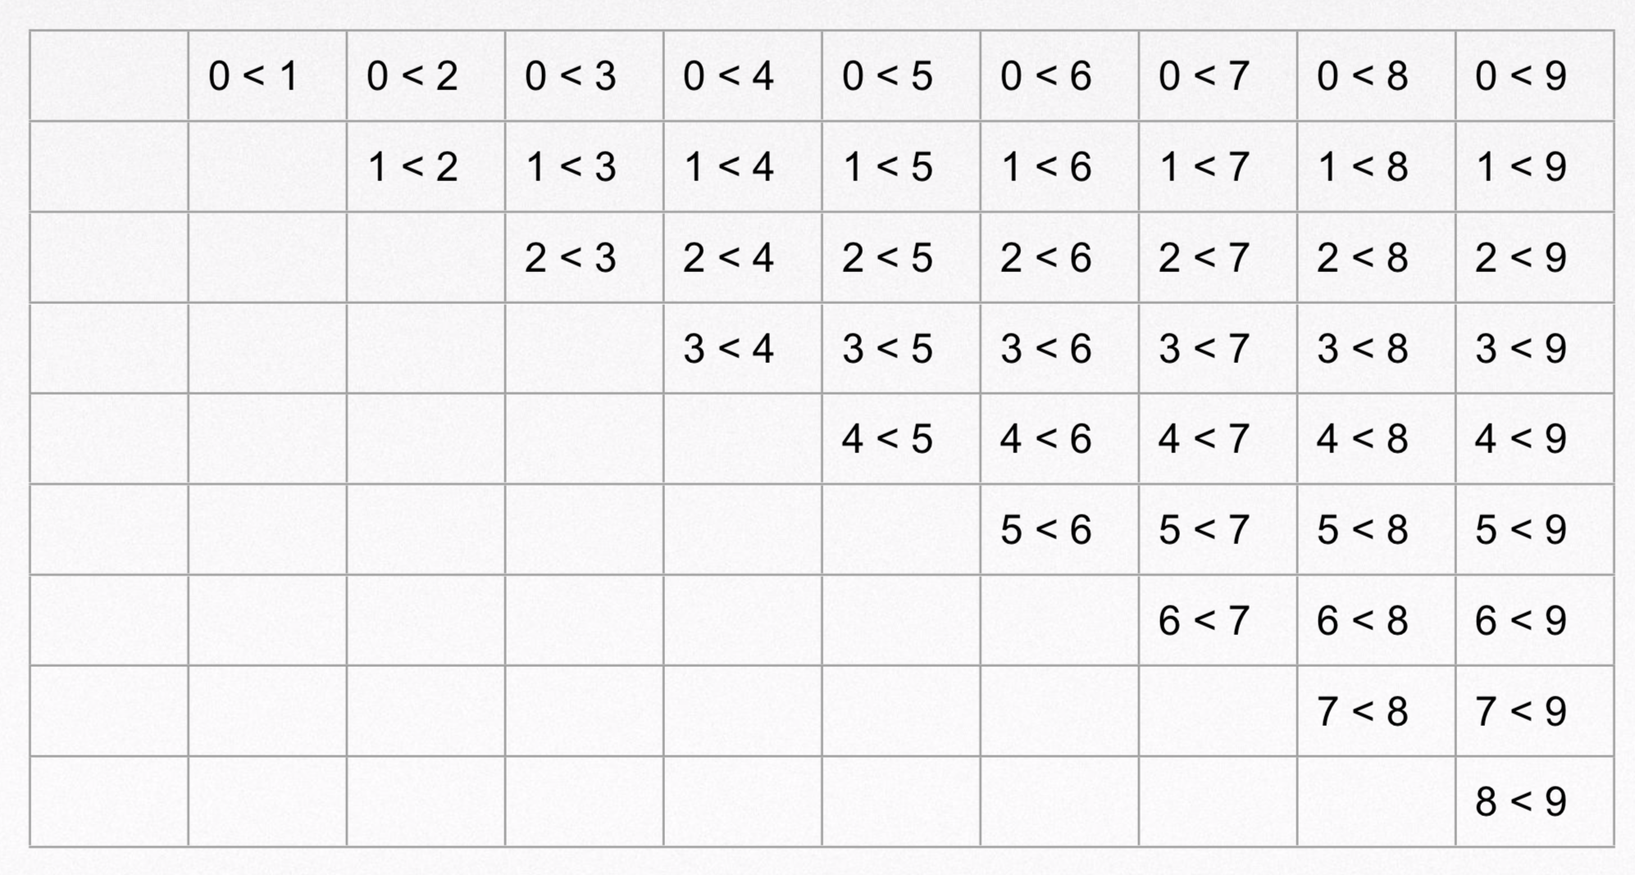

Slide 35
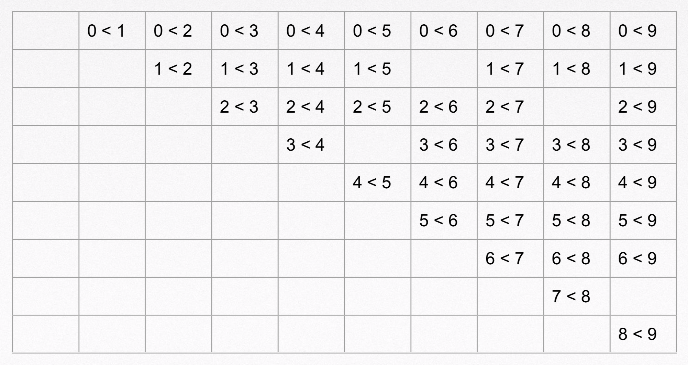

Slide 36
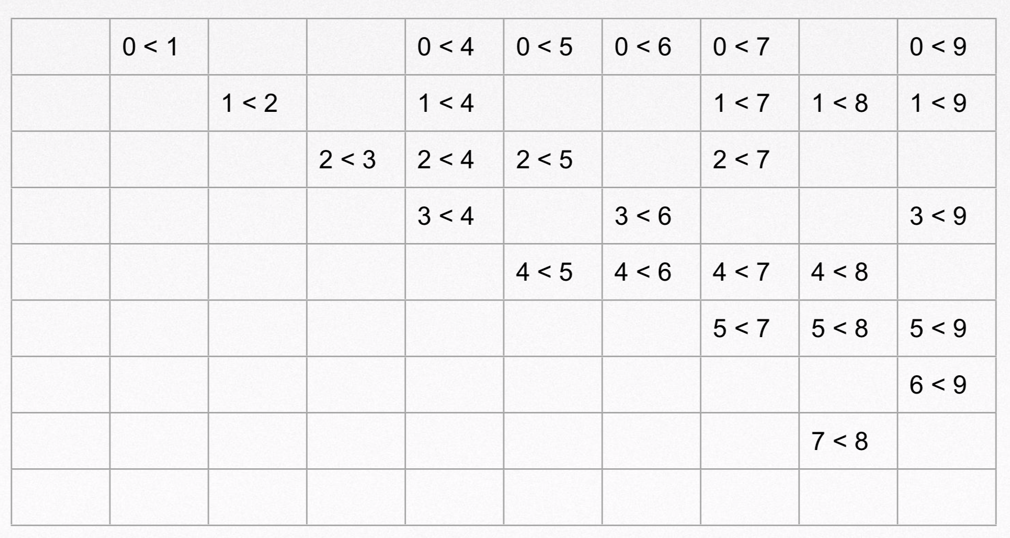

Slide 37
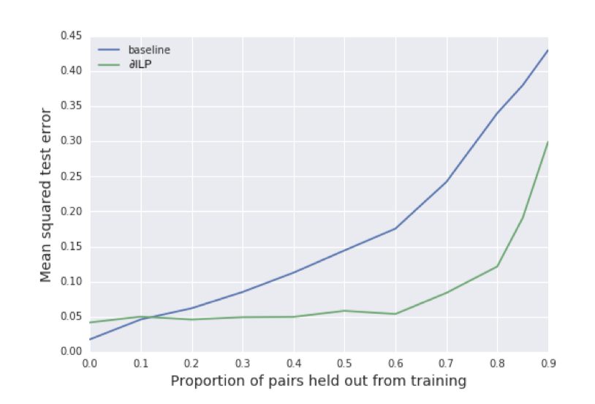

Slide 38
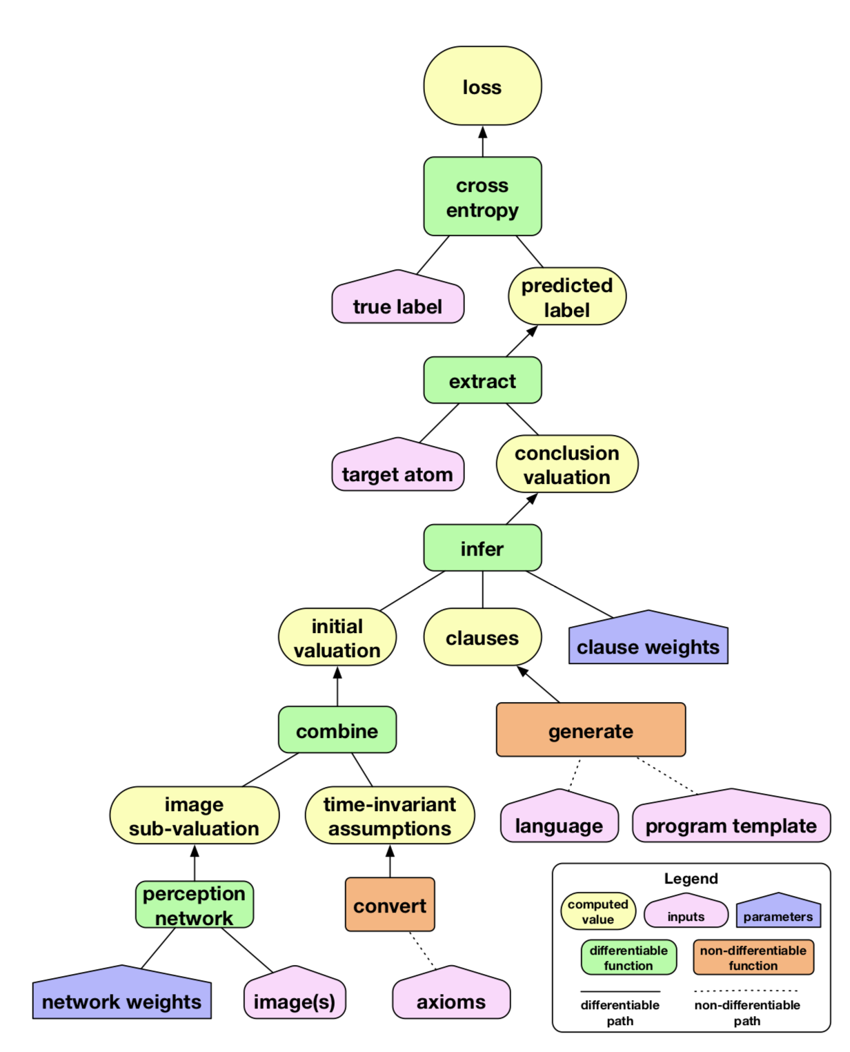
DNN+ILP

Slide 40
Another combination example

Slide 41
Thai printed character recognition by combining inductive logic programming with backpropagation neural network
ILP + Neural network

Slide 42
Thai printed character recognition by combining inductive logic programming with backpropagation neural network
ILP to learn rule for each character
Given example, how many predicates matching and how many unmatching
Fed the number of unmatching and matching predicates into Neuron Network

Slide 43
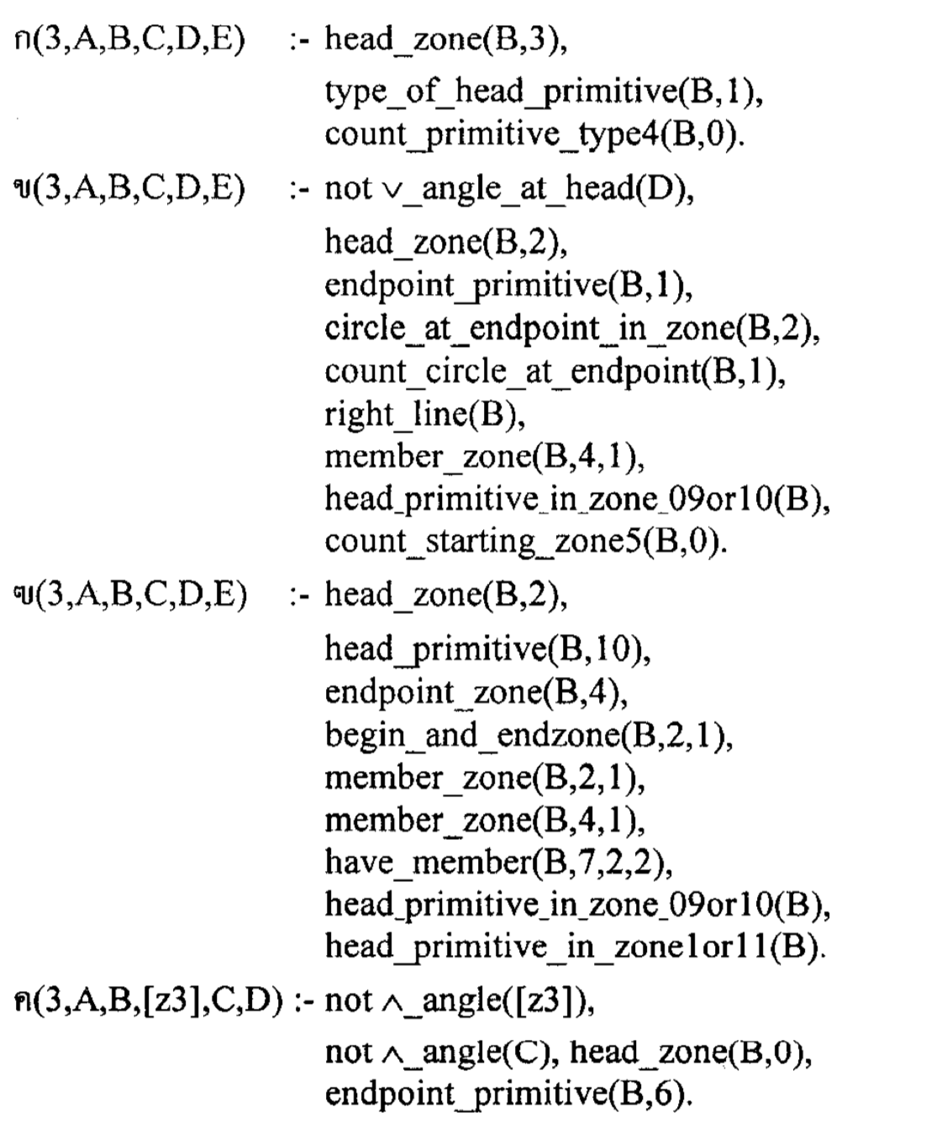
Thai printed character recognition by combining inductive logic programming with backpropagation neural network

Slide 44
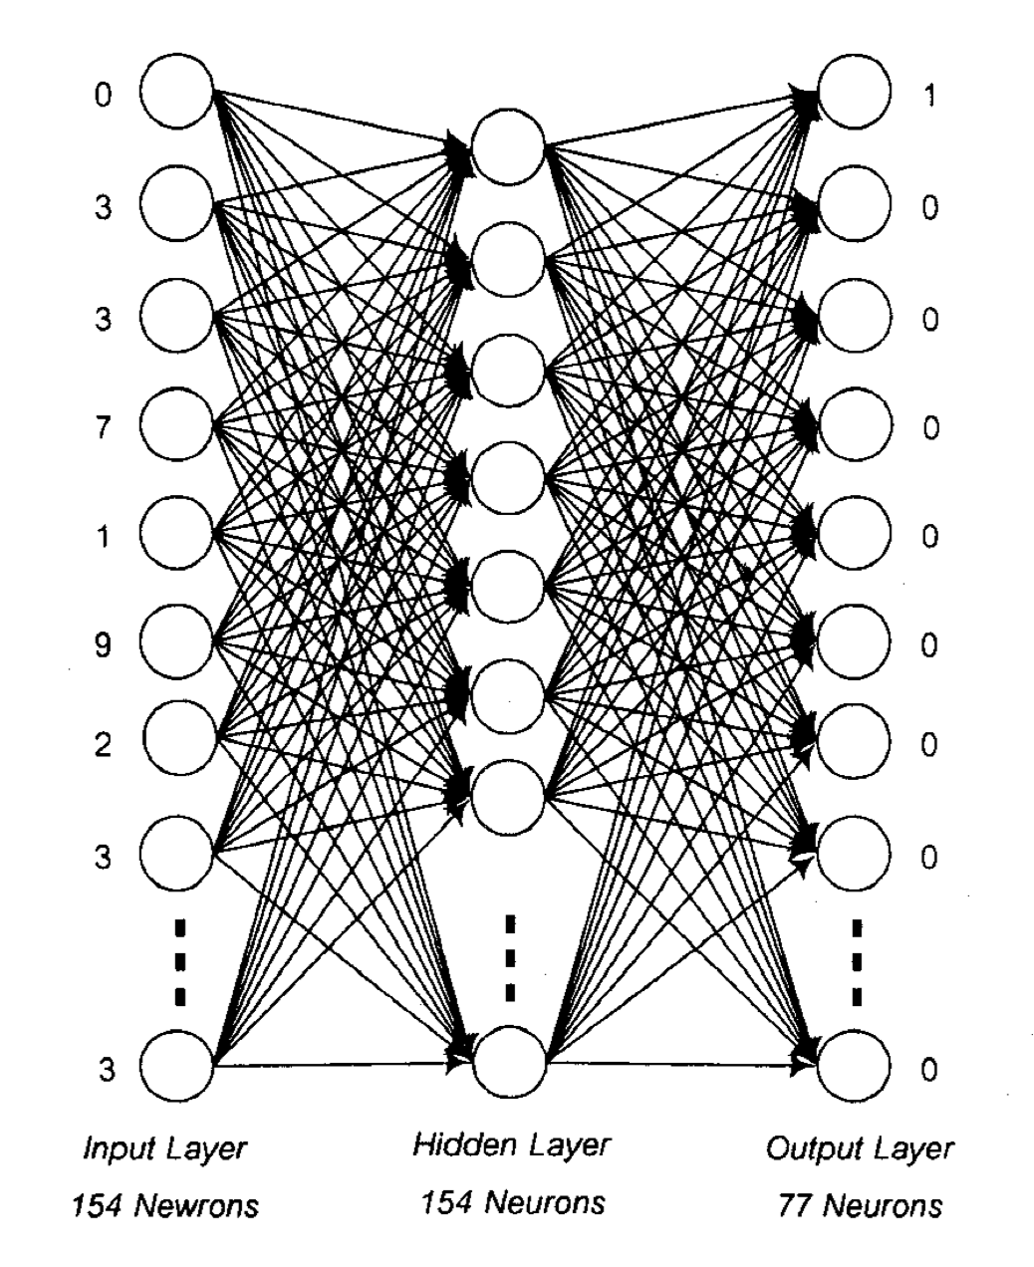
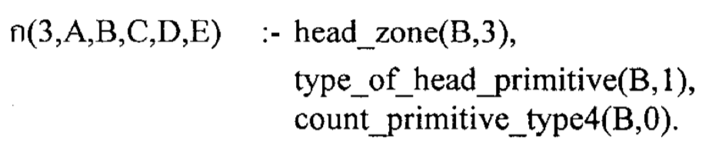
Example
Character rule 1
unmatching 0
mactching 3
Character rule 2
…
ก

Slide 45
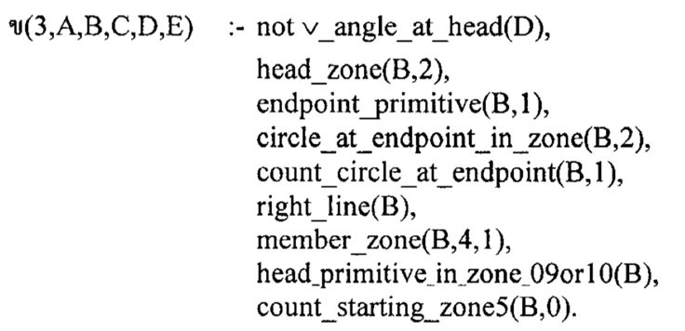
Example
Character rule 1
unmatching 0
mactching 3
Character rule 2
unmatching 3
matching 7
ก

Slide 46

Datasets

Slide 47
Datasets
Juliet Dataset
64099 individual test cases in C/C++
28881 individual test cases in Java
118 different CWEs
Draper VDISC Dataset
1.27 million functions
Function-level data

Slide 48
Juliet dataset

Slide 49
Draper VDISC dataset
code | CWE-119 | CWE-120 | CWE-121 | CWE-122
void(){ int… | 1 | 0 | 0 | 0
main(){ int .. | 0 | 1 | 0 | 0
xxxx | 1 | 0 | 0 | 0
xxxx | 0 | 0 | 0 | 1
xxx | 0 | 0 | 0 | 0

Slide 50
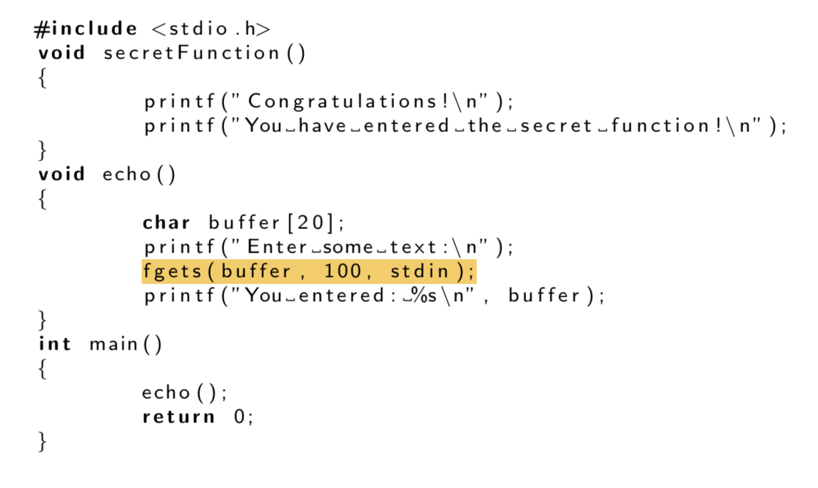
Our ideas: How it should be

Slide 51
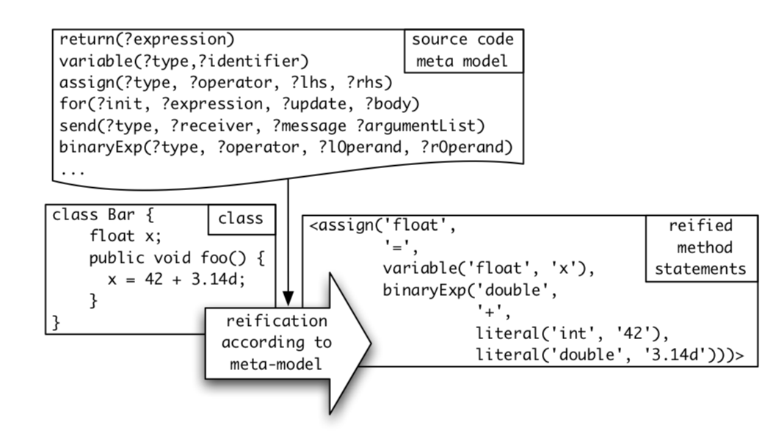
Code in programming languages

Slide 52
Find bugs
void echo()
{
char buffer[20];
fgets(buffer, 100, stdin);
printf(” %s\n”, buffer);
}
void echo()
{
char buffer[20];
fgets(buffer, 10, stdin);
printf(” %s\n”, buffer);
}

Slide 53
End-to-End Prediction of Buffer Overruns from Raw Source Code via Neural Memory Networks

Slide 54
Labelled data
void fun ()
{
char var[39] = "";
memset(var, 'L’, 39-1);
var[39-1]='0';
var[20] = ‘Y';
}
void fun ()
{
char var[9] = "";
memset(var, 'L’, 9-1);
var[9-1]='0';
var[10] = ‘Y';
}

Slide 55
Labelled data
void fun ()
{
char var[39] = "";
memset(var, 'L’, 39-1);
var[20] = ‘Y';
}
void fun ()
{
char var[9] = "";
memset(var, 'L’, 9-1);
var[9-1]='0';
var[10] = ‘Y';
}
5
6

Slide 56
Labelled data
void fun ()
{
char var[39] = "";
memset(var, 'L’, 39-1);
var[39-1]='0';
var[20] = ‘Y';
}
void fun ()
{
char var[9] = "";
memset(var, 'L’, 9-1);
var[9-1]='0';
var[10] = ‘Y';
}

Slide 57
How to input in a neural network
void fun ()
{
char var[39] = "";
memset(var, 'L’, 39-1);
var[39-1]='0';
var[20] = ‘Y';
}
Extract the features
void
fun
(
)
{
char
…
Word2vec

Slide 58
How to input in a neural network
Alphabet = { fun, void,(, ), {, char, …}
To a Word2vec
[0,1,0,0,…]
[1,0,0,0,…]
[0,0,1,0,…]
….
void fun ()
[2,1,3,4]
M
M is a row num*10000 matrix

Slide 59

How to input in a neural network
[0,1,0,0,…]
[1,0,0,0,…]
[0,0,1,0,…]
….
$$M_{3,10000}∗E_{10000,300}=V_{3,300}$$

Slide 60
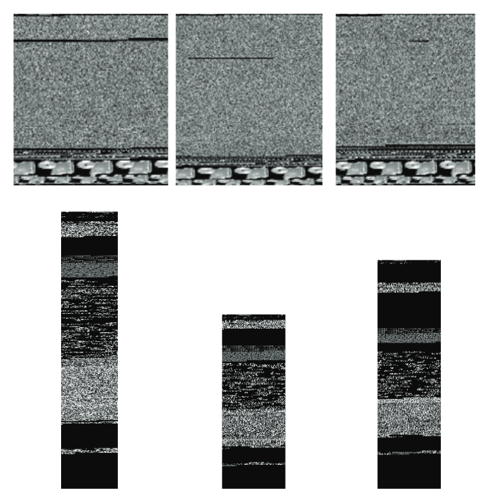
Binary sequence
010010101011010010
001010010101110010
001001010101001001
111101010010101001

Slide 61
Visualisation
code
Binary sequence
void fun ()
{
char var[39] = "";
memset(var, 'L’, 39-1);
var[39-1]='0';
var[20] = ‘Y';
}
010010101011010010
001010010101110010
001001010101001001
111101010010101001

Slide 62
Find the location
Understand what each line is doing
Figure out if it doing the right thing?

Slide 63
Simple Statements（assignment, return, etc)
Compound statements (do-loop, for-loop, if-statement, etc)

Slide 64
Bug detection
code
bug
code
Intermediate part
bug

Slide 65
Thank you

